Slide 1
Explainable and Prerequisite-Aware Knowledge Gap Detection Using Machine Learning and Deep Knowledge Tracing for Personalized Learning
An End-to-End AI-Driven Cognitive Gap Estimation & Adaptive Remediation Platform
Team Members
Academic Supervision
Sharath B
Reg No: 210425149057
Padmanaban R
Reg No: 210425149035
Project Guide: Prof. Prabu Deva
Instructor / Course Coordinator: Prof. Aruchana
Department:CSE(Cybersecurity)
92.40%
0.9865
XGBoost Accuracy
Macro ROC-AUC
525K
5
Interaction Logs
Deep Architectures

Slide 2

The Challenge: Why Traditional EdTech Falls Short
The Core Problem
Our Solution: EduGap AI
Traditional online assessment systems evaluate static final scores but fail to capture latent cognitive knowledge gaps, problem-solving hesitation, and prerequisite dependency gaps. Students receive a single numerical percentage with no diagnostic insight into why they struggled or which foundational concepts require remediation.
A dual-engine framework that replaces black-box grading with precision cognitive diagnostics:
Gradient-Boosted Decision Trees — XGBoost Champion Model, 92.40% Accuracy
Deep Knowledge Tracing — PyTorch LSTM, GRU, Transformer-DKT, GNN, Autoencoders
Explainable Performance Analytics — SHAP-aligned feature importance hierarchy
Session-Aware Remediation — Targeted study guides mapped to attended topics only
Static One-Size-Fits-All Quizzes
No real-time adaptation to individual skill mastery levels or learning trajectories
Black-Box Grading
Standard platforms output single numerical percentages without any diagnostic explanation or gap attribution
Recommendation Misalignment
Students assigned generic practice problems without targeting specific gap severity or prerequisite dependencies

Slide 3






Technical ML & Data Processing Pipeline
End-to-end machine learning workflow for EduGap AI, from raw ASSISTments logs through zero-leakage feature engineering, dual-model training, and diagnostic remediation output.
Step 1 — Raw Data Ingestion
Step 2 — Preprocessing & Imputation
ASSISTments 525K student interaction logs enter the pipeline as the foundational event stream.
Median fills response latency gaps, while mode imputes missing tutor types for stable downstream modeling.
Step 3 — Logarithmic Transformation
Step 4 — Zero-Leakage Feature Extraction
log_ms_response = log1p(ms_first_response) reduces skew and normalizes heavy-tailed response times.
Compute hint_ratio, attempt_hint_sum, user_skill_hints, and user_skill_attempts without leaking target information.
Step 5 — Dual Model Training & Calibration
Step 6 — Diagnostic Output & Remediation
XGBoost reaches 92.40% while PyTorch LSTM/GRU/Transformer DKT, GCN concept graphing, and Autoencoder 4D latent compression refine predictive power.
Chart.js severity gauges, color-coded answer review, Khan Academy videos, Master Study Notebooks, and A4 PDF downloads drive actionable learning support.

Slide 4
Data Pipeline & Preprocessing Workflow
Benchmark Dataset
Four-Stage Preprocessing Protocol
ASSISTments Benchmark Dataset
01
525K
Data Cleaning & Imputation
Median imputation for continuous metrics (ms_first_response, overlap_time); Mode imputation for categorical features (tutor_mode, answer_type)
Student Interaction Logs
02
3
Latency Log Scaling
Balanced Target Classes
Applied log-transformation:
High · Medium · Low Gap

Slide 5



Behavioral Feature Extraction (Zero Label Leakage)
All 7 core sequential attributes are derived purely from observable student behavior — no answer-correctness leakage into input features. Each attribute encodes a distinct cognitive signal that drives the gap estimation models.
1
2
3
correct
attempt_count
hint_count
Binary item accuracy (1.0 or 0.0) — immediate response outcome
Number of repeated submission attempts — persistence and retry signal
Total hints requested — direct help-seeking behavior measure
4
5
6
hint_ratio
log_ms_response
log_overlap_time
Normalized hint dependency: hint_count / (hint_total + 1)
Log-transformed response latency (ms) — primary struggle indicator
Log-scaled session interaction duration — cognitive engagement depth
7
attempt_hint_sum
Combined struggle index: attempt_count + hint_count
The feature set is intentionally constrained to behavioral proxies — no raw answer text, no topic labels, and no score fields enter the model. This guarantees the classifier learns genuine cognitive patterns rather than shortcut correlations.
Historical Skill Memory: Aggregated user_skill_hints and user_skill_attempts model longitudinal student persistence and learning trajectory across sessions.

Slide 6
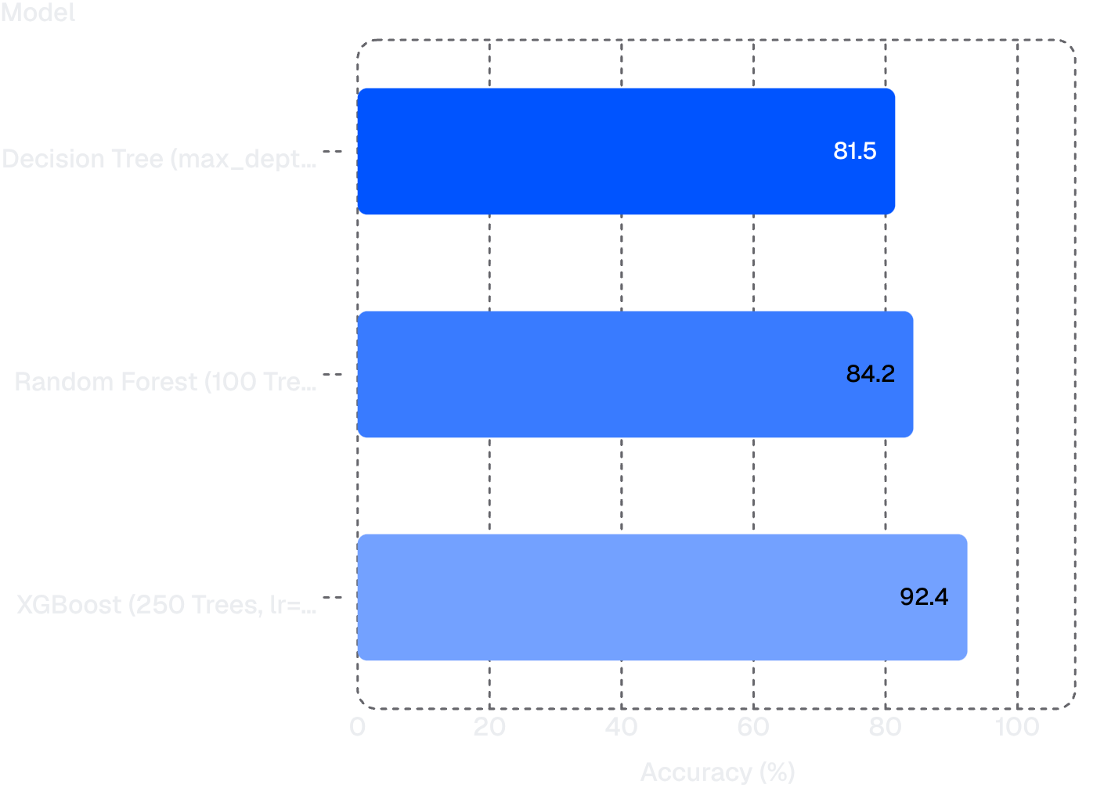
Machine Learning Classifiers & Comparative Analysis
Model Performance Comparison
⭐ XGBoost Champion Model — Full Metrics
Configuration: 250 Gradient-Boosted Trees, learning rate = 0.08
92.40%
Test Accuracy
0.9865
Macro ROC-AUC
Precision
Recall
0.9240 — balanced across all 3 gap classes
0.9240 — no class penalized
XGBoost outperforms all baselines by a margin of +8.20 percentage points over Random Forest and +10.95 points over the Decision Tree baseline — confirming gradient boosting as the optimal architecture for this classification task.
F1-Score
0.9240 — macro-averaged

Slide 7




Deep Knowledge Tracing & Advanced Deep Architectures
Five distinct deep learning architectures were trained and evaluated to capture temporal learning dynamics, long-range skill dependencies, concept graph relationships, and latent cognitive state compression.
PyTorch LSTM & GRU
Transformer-DKT (SAKT)
Formulated 10-step interaction tensor [1, 10, 7] tracking sequential learner behavior.
GRU Test Accuracy: 92.25%
Multi-Head Self-Attention with Sinusoidal Positional Encoding for temporal awareness. Captures long-range skill decay.
Test Accuracy: 91.25%
Graph Neural Networks (GCN)
Knowledge Autoencoders
20-node Normalized Concept Dependency Graph mapping prerequisite math skill relationships across curriculum topics
4D Latent Knowledge Vector: 7D → 16D → 4D
Captures Mastery, Hesitation Rate, Help Dependency, Velocity.
MSE Loss: 0.0194
92.25%
91.25%
GRU Accuracy
Transformer Accuracy
0.0194
4D
Autoencoder MSE
Latent Vector

Slide 8

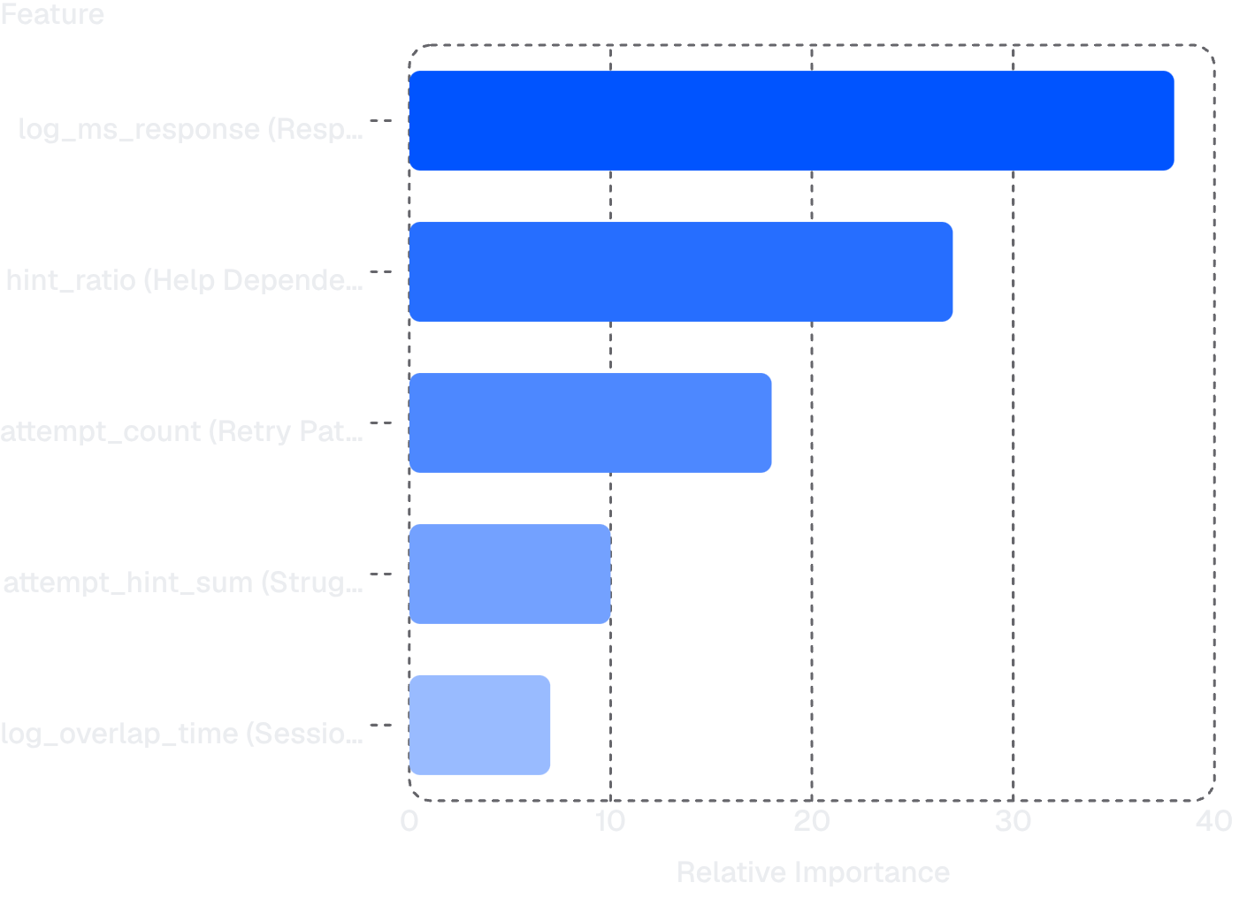
Explainability & Model Diagnostic Evaluation
Multi-Class ROC Curve Analysis
Feature Importance Hierarchy
One-vs-Rest (OvR) ROC curves computed independently across all three gap thresholds — High, Medium, and Low. The Macro AUC of 0.9865 confirms excellent discrimination with no class penalized.
XGBoost's built-in gain-based feature importance identifies the top cognitive gap predictors — providing transparent, human-interpretable explanations for every gap classification decision.
98.65%
Macro AUC Score
Excellent multi-class discrimination
Confusion Matrix & Class Balance
Seaborn confusion matrix analysis evaluated true positives and false positives across all three gap classes. Results confirm zero class bias and optimal prediction confidence — the classifier does not systematically favor any single gap category.
Response latency is the primary indicator of struggle, followed by hint dependency and retry persistence — confirming that temporal hesitation and help-seeking behavior are the strongest proxies for latent knowledge gaps.

Slide 9


Dedicated Assessment Review System (/review)
Problem Solved
Key Review Interface Features
The dedicated /review portal replaces inadequate inline summary cards with a comprehensive, answer-by-answer diagnostic feedback interface — giving students full transparency into every decision they made during the assessment.
High-Contrast White Text
Side-by-Side Comparison Cards
Interactive Quick Filters
Maximum legibility for long mathematical question statements — optimized for extended diagnostic reading sessions
"Your Selected Answer" displayed in Red (incorrect) or Green (correct) vs "Correct Answer" in a dedicated Green confirmation box — immediate visual gap attribution
All (10) — Complete session overview with counter badge
❌ Wrong — Isolated incorrect responses for targeted review
✅ Correct — Confirmed mastery items for confidence mapping
Color-Coded Visual Feedback
Instant Counter Badges
Real-time tally of total, wrong, and correct counts update dynamically with filter selection — no page reload required
Immediate visual distinction between correct and incorrect responses — reduces cognitive load during post-assessment analysis

Slide 10



Session-Aware AI Recommendation & Study Guides
Strict Session Filtering Logic
Integrated Multi-Modal Learning Resources
The load_resources() function enforces strict topic-level filtering: recommendations display only the 10 specific topics attended in that test session. Weak skills are sorted to the top for prioritized remediation — eliminating irrelevant content noise entirely.
Khan Academy Video Lessons
Verified video embeds for conceptual reinforcement — each weak skill mapped to a curated external lesson
Personalized Learning Path
Master Academic Study Notebooks
Adaptive difficulty progression based on real-time mastery level assessment. All study materials are offline-accessible for continuous learning beyond the platform session.
Comprehensive theory, governing formulas, step-by-step solved problems across 4 difficulty levels: Basic → Intermediate → Applied STEM → Exam Challenge
Print-Ready A4 PDF Downloads
/pdf_notes/<skill> endpoint for one-click printable study guides — full offline access to curriculum-aligned reference material

Slide 11

Future Scope & Developing Further Features
1
2
3
4
Phase 1
Phase 2
Phase 3
Phase 4
Real-Time LLM-Driven Question Generation
Multi-Modal Biometric & Affective Computing
Multi-Disciplinary Subject Expansion
Institutional Analytics & Mobile Ecosystem
Scaling from 20 Math topics to Computer Science Algorithms
Data Structures, Physics, and Electrical Engineering
Cross-domain prerequisite mapping
Integrating Gemini / Llama 3 API for dynamic hint generation
Infinite practice problem synthesis
Adaptive difficulty scaling
Instructor dashboards for university tracking
Cross-platform Flutter/React Native mobile applications
Gamified mastery badges and leaderboards
Federated learning for multi-institution deployment
Eye-tracking integration
Keystroke dynamics analysis
Facial emotion detection for frustration and cognitive fatigue
Real-time learner state assessment

